Slide 1
Lecture by
Loops
Week 3
Dr Sarfraz Brohi
CSCT
October, 2023

Slide 2
Outline
Introduction to loops
Three forms of loops
while
do-while
for
Increment and decrement operators
Nested loops
Input from file
Case study
To do list

Slide 3
Introduction to Loops
Motivating example:
Example: Print "Welcome to C! " 100 times.
How would we do it?
Write the following statement 100 times?
printf("Welcome to C!");
That would be too tedious!
We would need to write a loop.

Slide 4
Loops
Loops are constructs that control repeated execution of a block of statements.
int count = 0;
while (count < 100) {
printf("Welcome to C!");
count++; // same as count = count + 1
}
A while loop starts with keyword while, followed by a Boolean expression for the condition, then followed by a statement body.
We also need to declare/initialise a variable for counting.

Slide 5
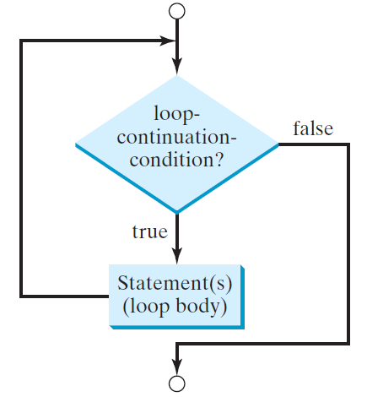
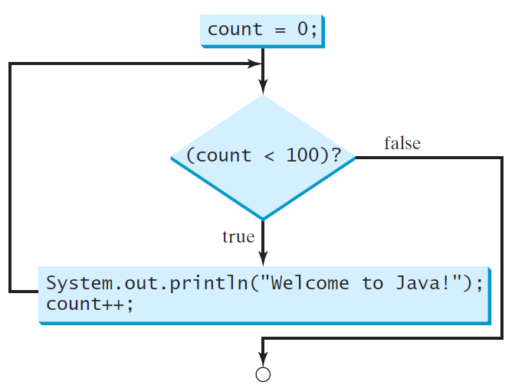
while Statements
int count = 0;
while (count < 100) {
printf(”Welcome to C!”);
count++;
}
while (Boolean-expression) {
statement(s);
}
printf(”Welcome to C!”);
count++
5
5

Slide 6
Trace while Loop
Initialize count to 0
int count = 0;
while (count < 2) {
printf("Welcome to C!");
count++;
}
6
6
6

Slide 7
Trace while Loop
int count = 0;
while (count < 2) {
printf("Welcome to C!");
count++;
}
While (count < 2) is true
(count is 0 at moment)
7
7
7
7

Slide 8
Trace while Loop
int count = 0;
while (count < 2) {
printf("Welcome to C!");
count++;
}
Print "Welcome to C!"
8
8
8
8
8

Slide 9
Trace while Loop
int count = 0;
while (count < 2) {
printf("Welcome to C!");
count++;
}
Increase count by 1
(count is increased to 1 now)
9
9
9
9
9
9

Slide 10
Trace while Loop
int count = 0;
while (count < 2) {
printf("Welcome to C!");
count++;
}
While (count < 2) is true
(count is 1 at moment)
10
10
10
10
10

Slide 11
Trace while Loop
int count = 0;
while (count < 2) {
printf("Welcome to C!");
count++;
}
Print "Welcome to C! "
11
11
11
11
11
11

Slide 12
Trace while Loop
int count = 0;
while (count < 2) {
printf("Welcome to C!");
count++;
}
Increase count by 1
(count is increased to 2 now)
12
12
12
12
12
12
12

Slide 13
Trace while Loop
int count = 0;
while (count < 2) {
printf("Welcome to C!");
count++;
}
While (count < 2) is false
(count is 2)
13
13
13
13
13
13

Slide 14
Trace while Loop
int count = 0;
while (count < 2) {
printf("Welcome to C!");
count++;
}
Exit the loop and execute the next statement after the loop.
14
14
14
14
14
14
14
14

Slide 15
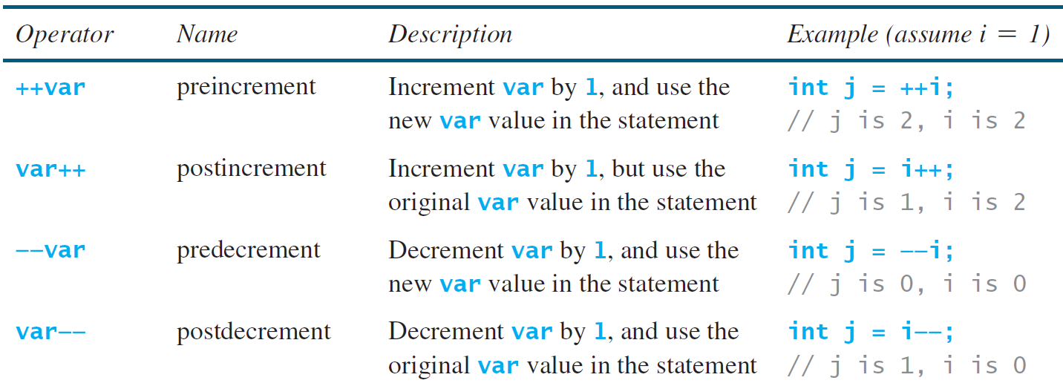
Increment and decrement operators
15
Notes:
1st pause

Slide 16
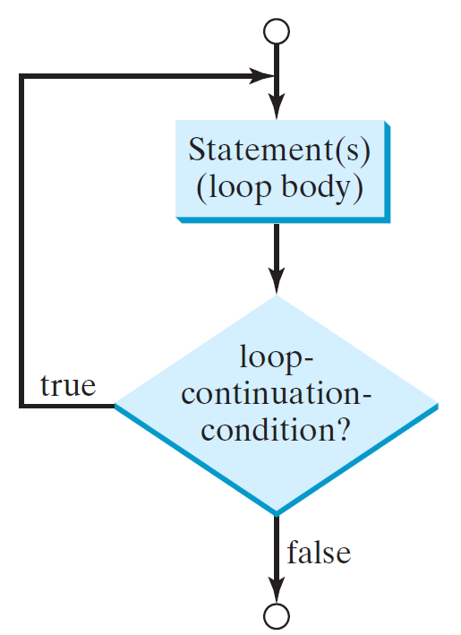
do-while Statements
do {
statement(s);
} while (Boolean-expression);
int count = 0;
do {
printf("Welcome to C!");
count++;
} while (count < 100);
Now compare it to:
int count = 0;
while (count < 100) {
printf("Welcome to C!");
count++;
}
What’s the difference between them?
16
16
16

Slide 17
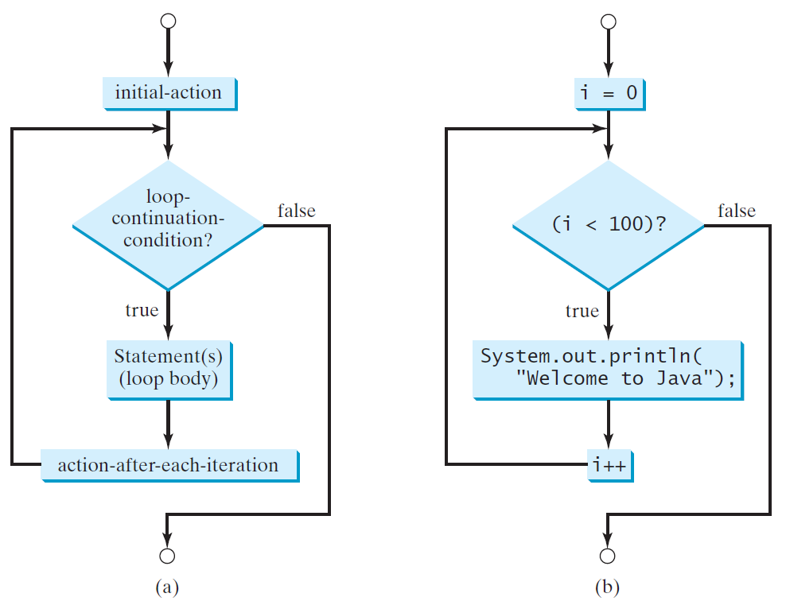
for Statements
for (initial-action; Boolean-expression; action-after) {
statement(s);
};
int i;
for (i = 0; i < 100; i++) {
printf(”Welcome to C!”);
};
printf(”Welcome to C!”);
17
17
17

Slide 18
Trace for Loop
Declare variable i
int i;
for (i = 0; i < 2; i++) {
printf("Welcome to C!");
} ;
18
18
18

Slide 19
Trace for Loop
int i;
for (i = 0; i < 2; i++) {
printf("Welcome to C!");
} ;
Initialise I to 0
(i is 0)
19
19
19
19

Slide 20
Trace for Loop
int i;
for (i = 0; i < 2; i++) {
printf("Welcome to C!");
} ;
(i < 2) is true
(i is 0)
20
20
20
20
20

Slide 21
Trace for Loop
int i;
for (i = 0; i < 2; i++) { printf("Welcome to C!");
} ;
Print "Welcome to C!"
21
21
21
21
21
21
21

Slide 22
Trace for Loop
int i;
for (i = 0; i < 2; i++) {
printf("Welcome to C!");
} ;
Increase i by 1
(i is increased to 1)
22
22
22
22
22
22
22

Slide 23
Trace for Loop
int i;
for (i = 0; i < 2; i++) {
printf("Welcome to C!"\n);
} ;
(i < 2) is true
(i is 1)
23
23
23
23
23

Slide 24
Trace for Loop
int i;
for (i = 0; i < 2; i++) {
printf("Welcome to C!");
} ;
Print “Welcome to C!”
24
24
24
24
24
24
24

Slide 25
Trace for Loop
Increase i by 1
(i is increased to 2)
int i;
for (i = 0; i < 2; i++) {
println("Welcome to C!");
} ;
25
25
25
25
25
25
25

Slide 26
Trace for Loop
(i < 2) is false
(i is 2)
int i;
for (i = 0; i < 2; i++) {
printf("Welcome to C!");
} ;
26
26
26
26
26
26

Slide 27
Trace for Loop
int i;
for (i = 0; i < 2; i++) {
printf("Welcome to C!");
} ;
Exit the loop and execute the next statement after the loop.
27
27
27
27
27
27
27

Slide 28
More on Loops
Using variables in the statement body.
int count = 0;
char name[20];
while (count < 100) {
printf("Please enter your name: \n");
scanf("%s", name);
printf("Hello, %s ”, name);
printf(" Welcome to C!\n");
count++;
}
Note that a loop repeats the execution of a block of statements each time but not necessarily produces the same result/output.
28
Notes:
Break for 10 minutes

Slide 29
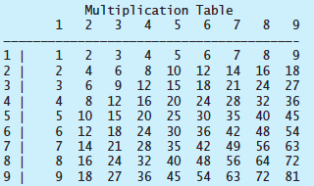
Nested Loops
A loop can be inside another loop.
Program example: Display a multiplication table.
j = 1, 2, …, 9
i = 1, 2, …, 9
29
29
29

Slide 30
Top-level design - program outline
/* Display a multiplication table
@author your name
*/
// Display the table heading
// Display column headings 1 to 9
//Display a line of hyphens
// Display rows 1 to 9
30
30
30
30

Slide 31
Design refinement – pseudo code
/* Display a multiplication table
@author your name
*/
//Display the table heading
//Display column headings 1 to 9
//for each column heading j
//Display j
//Display a line of hyphens
//Display rows 1 to 9
//for each row i
//for each column j in row i
//Display the product of i and j, i x j
31
31
31
31

Slide 32
Design refinement – add constructs
/* Display a multiplication table
@author your name
*/
int main() {
//Display the table heading
//Display column headings 1 to 9
//for (int j = 1; j <= 9; j++)
//Display j
//Display a line of hyphens
//Display rows 1 to 9
//for (int i = 1; i <= 9; i++) {
//for (int j = 1; j <= 9; j++) {
//Display the product of i and j, i x j
}
32
32
32
32
Notes:
Add program constructs into the pseudo code.

Slide 33
Implementation – add code
/* Display a multiplication table
@author your name
*/
#include <stdio.h>
int main() {
//Display the table heading
printf(" Multiplication Table \n");
//Display column headings 1 to 9
for (int j = 1; j <= 9; j++)
//Display j
printf("%4d", j); //align properly
//Display a line of hyphens
printf("\n———————————————————————————————————————\n");
//Display rows 1 to 9
for (int i = 1; i <= 9; i++) {
printf("%d | ", i);
for (int j = 1; j <= 9; j++)
//Display the product of i and j
printf("%4d", i * j); //align properly
printf("\n");
}
}
Escape sequence
Output formatting
33
33
33
33

Slide 35
Escape Sequences
Escape sequences
Any character after a single backslash , "\", in a string is not treated as a character anymore but as an instruction for a control action to be taken,
e.g. printf("\n———————————————————————————————————————\n");
"\n" : Newline, "\r" : Carriage return,
"\t" : Tab
Alternatively, a control character will be reverted back to a character,
e.g., "\"", "\’", "\\".

Slide 36
Output Formatting
We can use you can use printf()
Anything after the percentage sign is a formatting instruction.
e.g. printf("%4d", i * j);
"%4d": integer, minimum 4 digits
"%.2f": real number, 2 digits after the decimal point
36

Slide 37
Input from file – use of fscanf()
#include <stdio.h>
//define a file pointer for the file to hold a disk //location
FILE *fp;
int main() {
//open the file and assign its address to file //pointer
fp = fopen("radiusFile.txt", "r");
//declare variables for radius and area
//Prompt a radius is read from file
//read a value into radius from file
fscanf(fp, "%f", &radius);
//Compute the area given a radius and
//assign the result to area
//Display result (i.e. the value of circle)
fclose(fp); // always close files you've opened
} //main
37
37
37
37
37
37
37
37
37
37

Slide 38
Case Study – Predicting Future House Prices
In this case study, we learn how to design a solution for a given problem, and how to write a program containing a while loop to implement the designed solution.
38

Slide 39
Problem Specification
Design, implement, run and test a program that predict future house prices and display them.
Suppose that the average house price for a city is £200,000 this year and it increases 5% every year. In how many years will the average house price be doubled?
39
39
39
39
39

Slide 40
Top-level design – program outline
/* Predict future house price
@author your name
*/
//set initial price to 200000 and year to 0
//increase price for another year while price < 400000
//Display predicted year and price
40
40
40
40
40

Slide 41
Design refinement – pseudo code
/* Predict future house price
@author your name
*/
//set initial price to 200000 and year to 0
//increase price for another year while price < 400000
//while price < 400000
//increases price by 5%
//increment year by 1
//Display predicted year and price
41
41
41
41
41

Slide 42
Design refinement – add constructs
/* Predict future house price
@author your name
*/
int main() {
//set initial price to 200000 and year to 0
//increase price for another year while price < 400000
while (price < 400000) {
//increases price by 5%
//increment year by 1
}
//Display predicted year and price
}
42
42
42
42
42

Slide 43
Implementation – add code
/* Predict future house price
@author your name
*/
#include <stdio.h>
int main() {
//set initial price to 200000 and year to 0
double price = 200000; // price in year 0
int year = 0;
//increase price for another year while price < 400000
while (price < 400000) {
price = price * 1.05; //increases price by 5%
year++; //increment year by 1
}
//Display predicted year and price
printf("Price will be doubled in %d years \n", year);
printf("Price will be £%.2f in %1d years \n", price, year);
}
43
43
43
43
43
43
43
43
43
43

Slide 44
Which Loop to Use?
Three forms of loops are expressively equivalent.
In general, a for loop may be used if the number of iterations is known; A while loop may be used if the number of iterations is not known; A do-while loop can be used to replace a while loop if the loop body has to be executed at least once.
44
44
44

Slide 45
To Do Before the Next Lecture
Read lecture 3 slides.
Read and run Lecture 3 program examples.
Attend your practical session exercises covering all the topics in lecture 3.
Read relevant materials that cover lecture’s topics.
Glance through relevant materials that cover lecture 4’s topics.
Notes:
Create a subfolder, lecture3, in the POP folder and download all the program and input files into lecture3.

